Slide 1
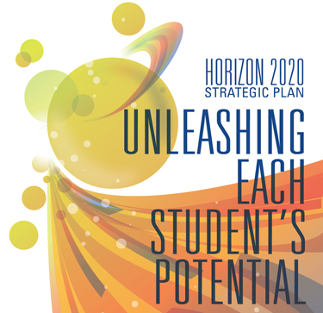
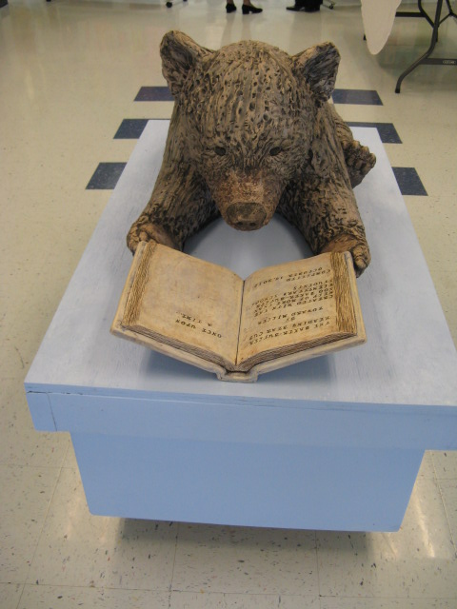
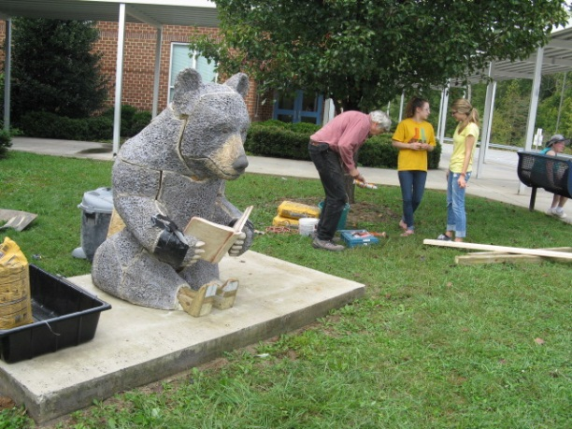
Baker-Butler Elementary School Improvement Plan
Presented By: David Cushman
Date: February 13, 2014

Slide 2
2013-14 Improvement Goals
All BBES students will attain at least one-year’s growth in Reading and Math.
Professional Development connecting Reading and Math instruction with STEAM, LLC and 7-Pathways to Student Learning.
Student emotional and physical safety will be enhanced through structures that reduce negative behavior and incidents of bullying.

Slide 3
Why These Goals are Important
Foundation:
  Student success and opportunity as 21st century learners, workers and citizens.
Engagement:
  Engaging, continuous improvement for adult and student learners through engaging work, unique experiences and varied learning environments.
Community:
  Positive learning environment supported by safety awareness, anti-bullying practices and good citizenship.

Slide 4
Current Challenges
The jobs of tomorrow are known only to the future.
Instilling an urgency in stakeholders to equip young learners with tools and knowledge to meet the challenges of a competitive global economy.
Ensuring that students are empowered to own their future by emphasizing Lifelong Learner Competencies and providing varied learning environments, essential tools of contemporary learners and unique experiences and opportunities.
Continuous academic progress for all students – all means all.
  Successive student population shifts
  Support for RTI Tier I, II, III students
  Increase reading and math performance for AMO groups 1, 2, 3
  Homework completion
  Attendance
  Parent involvement
  Common understandings of the most effective math and reading instruction strategies.

Slide 5
Current Successes
Improved monitoring and follow through of students who are habitually tardy or absent:
  Attendance committee reviews progress
  Attendance clerk prepares attendance and tardy data
  Administrators follow up with parents - letter, phone call, meeting, JDC
Partnering with parents to increase the level of family involvement in school activities and support for student work:
  SBIT meetings, PTO events, curriculum nights, “School and Community Friendship Network.”
Assessing one year’s growth using multiple measures that can be mutually verified to affirm student progress:
  Student progress in reading and math for all students in grades K-5 was reviewed at Midyear Review meeting on February 6th, 2014.
  New RTI pilot streamlining process, universal screeners, progress monitoring
  Balanced assessments using benchmark tests, portfolios, performance tasks, etc.
  Varied presentation modes – story, poem, article, letter, song, art work, poster, technology enhanced, etc.

Slide 6
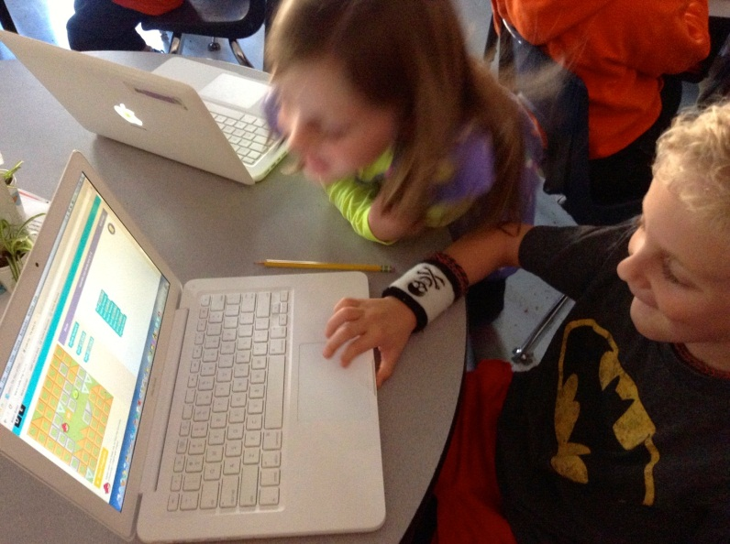
Beginning Computer Coding
“Hour of Code”

Slide 7
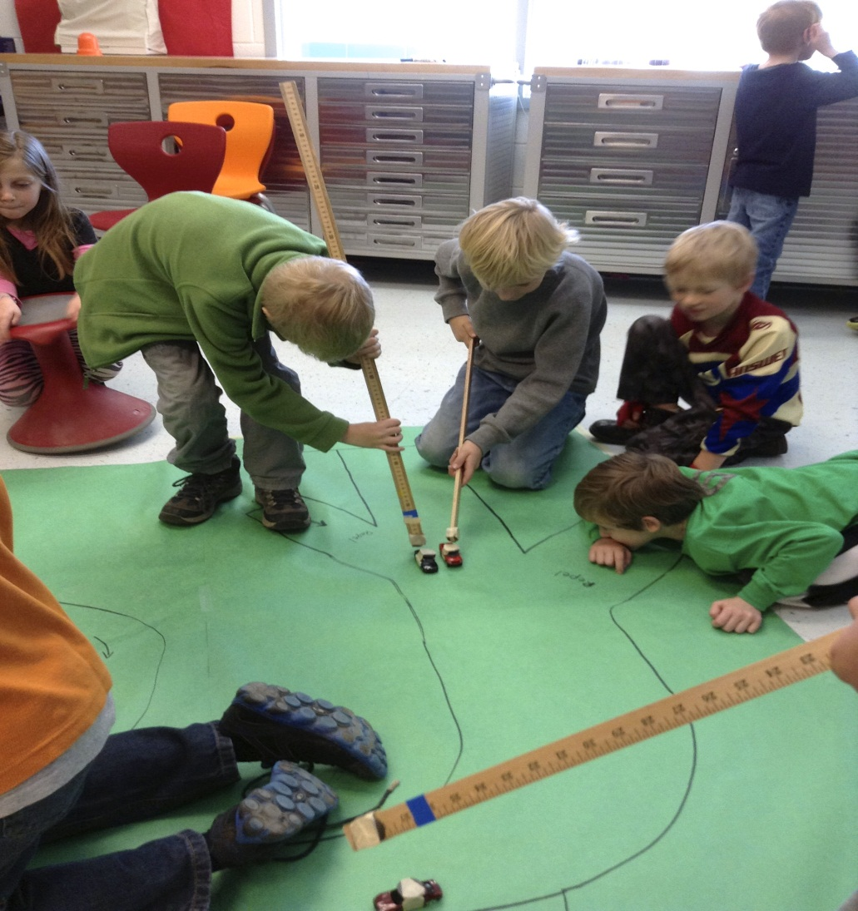
7-Pathways to Student Learning
Magnet Races
Universal Design is responding to individual needs and strengths by allowing multiple ways of accessing the curricula.
It is a lot more fun, meaningful and memorable to have a “magnet race” than to sit at a desk and read about polarity.

Slide 8
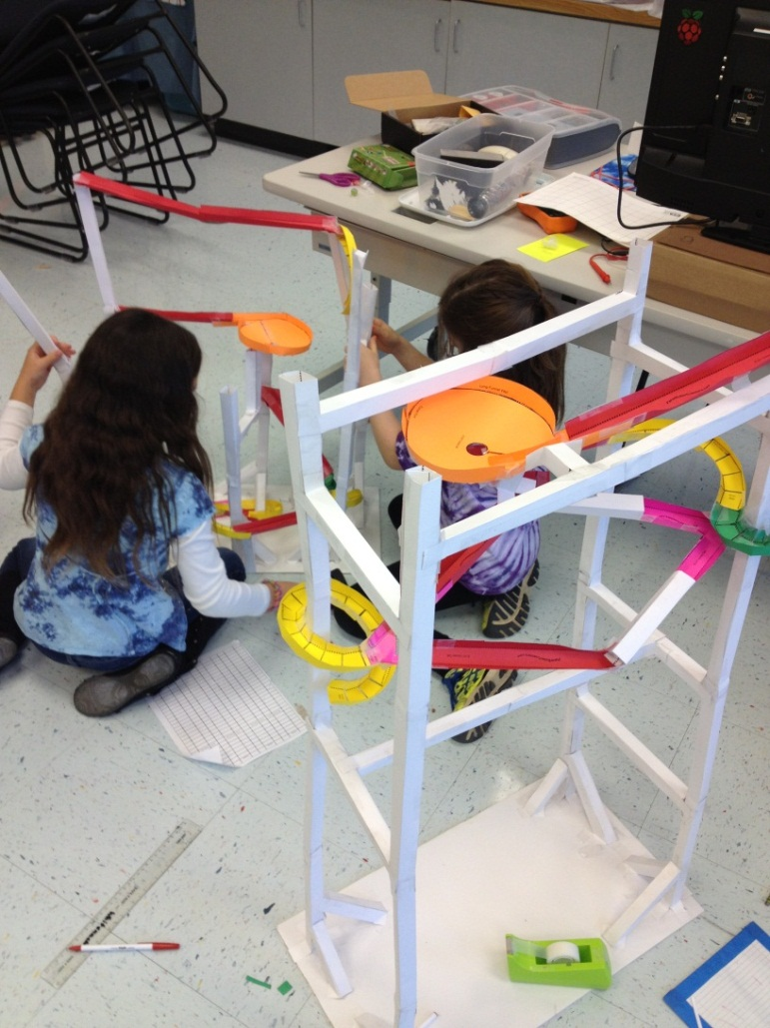
CREATION STATION
Marble Roller Coaster Challenge
Marble Run Roller Coaster Challenge
Virginia Regions Salt Dough Maps Modeling
Scarecrow Design
Columbus Day Boats
Engineering Towers
American Indian Corn Husk Dolls
Matter Day
Panda Research Project
LED Light Design
Magnet Races
Invertebrate Day
Cell Mapping Projects
Hour of Code
Biomes Discovery and Research
Flight Experiments
Survival Project
Division Project

Slide 9
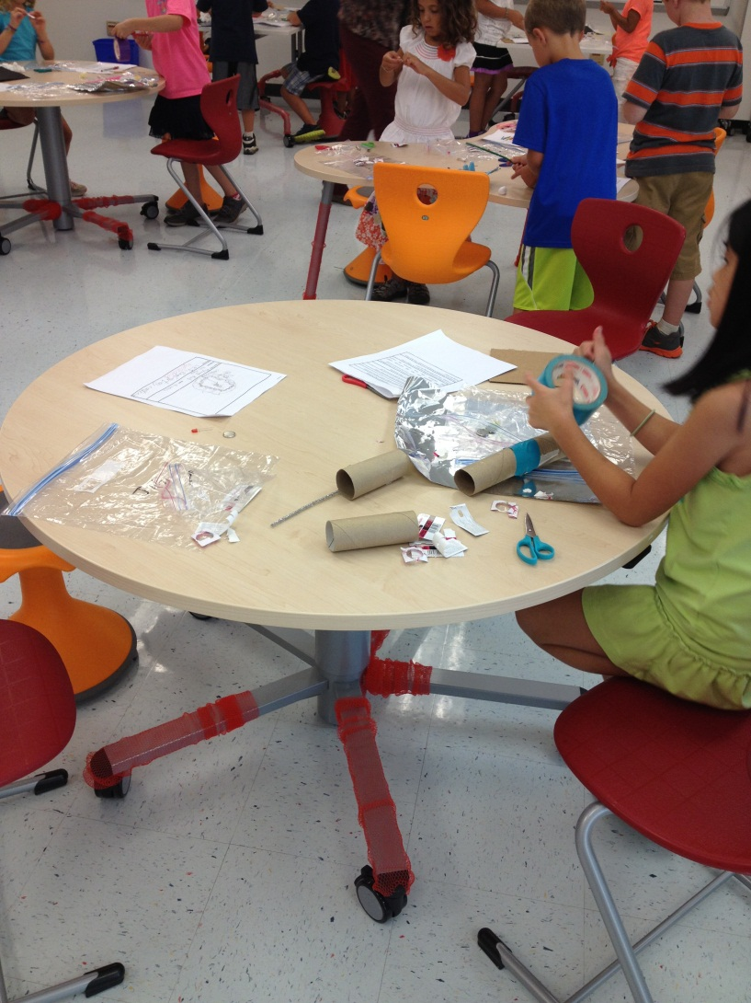
Our Students Love their new
Creation Station Learning Space!

